Slide 1

CSE- 207
Algorithms
Lecture: 16
Graph: BFS-DFS
Fahad Ahmed
Lecturer, Dept. of CSE
E-mail: fahadahmed@uap-bd.edu

Slide 2
Graph

Slide 3
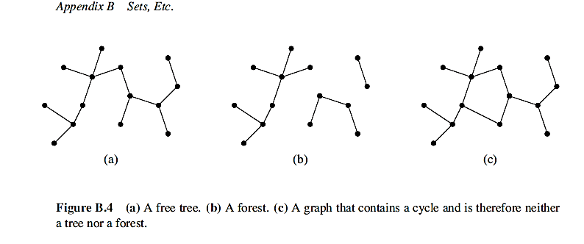
Tree
Tree: Connected Acyclic undirected graph
Forest: If an undirected graph is acyclic but possibly disconnected, it is a forest
Spanning Tree: a tree that connects all the vertices of a graph with the minimum possible number of edges.

Slide 4
Properties of trees
Tree is a discrete structure that represents hierarchical relationships between individual elements or nodes. A tree in which a parent has no more than two children is called a binary tree.
Tree contains no cycles and has n-1 edges.
Tree is connected graph, and every edge is a cut-edge.
Any two vertices of graph Tree are connected by exactly one path.

Slide 5
Graph-searching Algorithms
Given: a graph G = (V, E), directed or undirected
Goal: methodically explore every vertex and every edge
Ultimately: build a tree on the graph
Pick a vertex as the root
Choose certain edges to produce a tree
Note: might also build a forest if graph is not connected
Used to discover the structure of a graph.

Slide 6
Graph-searching Algorithms
Standard graph-searching algorithms.
Breadth-first Search (BFS).
Depth-first Search (DFS).
“Search as deep as possible first.”

Slide 7
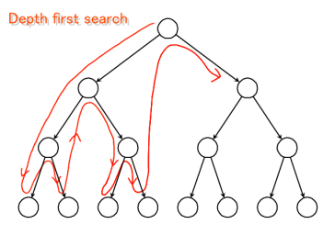
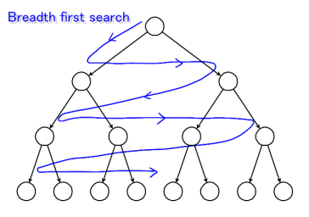
Graph Traversals
Both take time: O(V+E)

Slide 8
BFS
Algorithmic Steps
Step 1: Push the root node in the Queue.
Step 2: Loop until the queue is empty.
Step 3: Remove the node from the Queue.
Step 4: If the removed node has unvisited child nodes, mark them as visited and insert the unvisited children in the queue

Slide 9
BFS
Algorithmic Procedure
BFS(G,source):
Q=queue(), level[]=infinity
Q.enqueue(source)
level[source]=0
while Q is not empty
u ← Q.pop()
for all edges from u to v in G.adjacentEdges(v) do
if level[v] = infinity:
level[u]=level[v]+1;
Q.enqueue(v)
end if
end for
end while
Return distance;

Slide 10
Example (BFS)
r
s
t
u
∞
0
∞
∞
∞
∞
∞
∞
v
w
x
y
Q: s
0

Slide 11
Example (BFS)
r
s
t
u
1
0
∞
∞
∞
1
∞
∞
v
w
x
y
Q: w r
1 1

Slide 12
Example (BFS)
r
s
t
u
1
0
2
∞
∞
1
2
∞
v
w
x
y
Q: r t x
1 2 2

Slide 13
Example (BFS)
r
s
t
u
1
0
2
∞
2
1
2
∞
v
w
x
y
Q: t x v
2 2 2

Slide 14
Example (BFS)
r
s
t
u
1
0
2
3
2
1
2
∞
v
w
x
y
Q: x v u
2 2 3

Slide 15
Example (BFS)
r
s
t
u
1
0
2
3
2
1
2
3
v
w
x
y
Q: v u y
2 3 3

Slide 16
Example (BFS)
r
s
t
u
1
0
2
3
2
1
2
3
v
w
x
y
Q: u y
3 3

Slide 17
Example (BFS)
r
s
t
u
1
0
2
3
2
1
2
3
v
w
x
y
Q: y
3

Slide 18
Example (BFS)
r
s
t
u
1
0
2
3
2
1
2
3
v
w
x
y
Q: ∅

Slide 19
Example (BFS)
r
s
t
u
1
0
2
3
2
1
2
3
v
w
x
y
BF Tree

Slide 20
Application of BFS
Finding Shortest Path
network (Computer, transportation[highway, flight])
GPS finding direction with shortest distance
Broadcasting of network node
Social network find people within k distance
Crawlers in Search Engines

Slide 21
DEPTH-FIRST SEARCH

Slide 22
DFS
Algorithmic Steps
Step 1: Push the root node in the Stack.
Step 2: Loop until stack is empty.
Step 3: Peek the node of the stack.
Step 4: If the node has unvisited child nodes, get the unvisited child node, mark it as traversed and push it on stack.
Step 5: If the node does not have any unvisited child nodes, pop the node from the stack.

Slide 23
DFS Procedure
DFS-iterative (G, s): //Where G is graph and s is source vertex
let S be stack
S.push( s ) //Inserting s in stack
mark s as visited.
while ( S is not empty):
//Pop a vertex from stack to visit next
v = S.top( )
S.pop( )
//Push all the neighbours of v in stack that are not visited
for all neighbours w of v in Graph G:
if w is not visited :
S.push( w )
mark w as visited

Slide 24
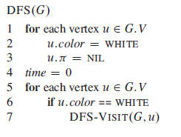
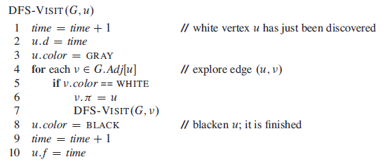
Pseudo-code
Uses a global timestamp time.

Slide 25
Example (DFS)
u
v
w
1/
x
y
z

Slide 26
Example (DFS)
u
v
w
1/
2/
x
y
z

Slide 27
Example (DFS)
u
v
w
1/
2/
3/
x
y
z

Slide 28
Example (DFS)
u
v
w
1/
2/
4/
3/
x
y
z

Slide 29
Example (DFS)
u
v
w
1/
2/
B
4/
3/
x
y
z

Slide 30
Example (DFS)
u
v
w
1/
2/
B
4/5
3/
x
y
z

Slide 31
Example (DFS)
u
v
w
1/
2/
B
4/5
3/6
x
y
z

Slide 32
Example (DFS)
u
v
w
1/
2/7
B
4/5
3/6
x
y
z

Slide 33
Example (DFS)
u
v
w
1/
2/7
F
B
4/5
3/6
x
y
z

Slide 34
Example (DFS)
u
v
w
1/8
2/7
F
B
4/5
3/6
x
y
z

Slide 35
Example (DFS)
u
v
w
1/8
2/7
9/
F
B
4/5
3/6
x
y
z

Slide 36
Example (DFS)
u
v
w
1/8
2/7
9/
F
B
C
4/5
3/6
x
y
z

Slide 37
Example (DFS)
u
v
w
1/8
2/7
9/
F
B
C
4/5
3/6
10/
x
y
z

Slide 38
Example (DFS)
u
v
w
1/8
2/7
9/
F
B
C
4/5
3/6
10/
B
x
y
z

Slide 39
Example (DFS)
u
v
w
1/8
2/7
9/
F
B
C
4/5
3/6
10/11
B
x
y
z

Slide 40
Example (DFS)
u
v
w
1/8
2/7
9/12
F
B
C
4/5
3/6
10/11
B
x
y
z

Slide 41
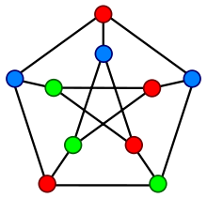
Graph Coloring Problem
Graph coloring problem involves assigning colors to certain elements of a graph subject to certain restrictions and constraints.
In other words, the process of assigning colors to the vertices such that no two adjacent vertexes have the same color is caller Graph Coloring.
This is also known as vertex coloring.

Slide 42
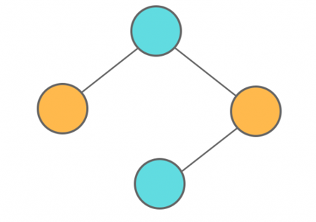
Graph Coloring Problem
Chromatic Number: The smallest number of colours needed to colour a graph G is called its chromatic number.
For example, in the above image, vertices can be coloured using a minimum of 2 colours.
Hence the chromatic number of the graph is 2.

Slide 43
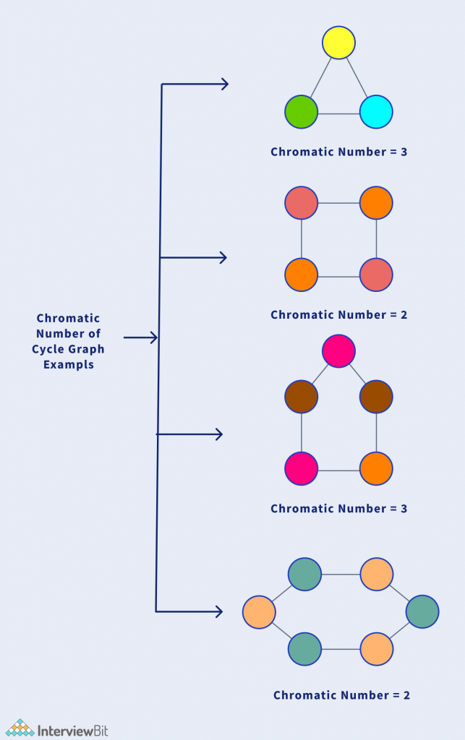
Graph Coloring Problem
Applications of Graph Colouring:
Map Coloring
Scheduling the tasks
Preparing Time Table
Assignment
Conflict Resolution
Sudoku

Slide 44
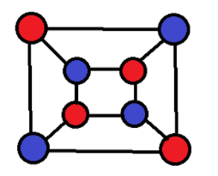
bipartite graph
A bipartite graph, also called a bi-graph, is a set of graph vertices decomposed into two disjoint sets such that no two graph vertices within the same set are adjacent.
A bipartite graph is a special case of a k-partite graph with k=2.
The illustration above shows some bipartite graphs, with vertices in each graph colored based on to which of the two disjoint sets they belong.
Bipartite graphs are equivalent to two-colorable graphs. All acyclic graphs are bipartite.

Slide 45
bipartite graph
To properly color any bipartite graph,
Minimum 2 colors are required.
This ensures that the end vertices of every edge are colored with different colors.
Bipartite graphs contain no odd cycles.
Every sub graph of a bipartite graph is itself bipartite.
If graph is bipartite with no edges, then it is 1-colorable.

Slide 46
bipartite graph
isBipartite(G,src){
Let q be an empty queue
s = src
colour v Red
q.enqueue(s)
while !q.empty()
u = q.dequeue()
for each v in u.adjuptoList:
if v.color is nil:
v.color = (u.color == Red) ? Black : Red
q.enqueue(v)
elif v.color == u.color:
return "Not Bipartite"
return "Bipartite"
}
Solution Code: https://www.geeksforgeeks.org/bipartite-graph/

Slide 47
bipartite graph
Complexity:
If Adjacency matrix is used, then:
Worst time complexity case: O(V^2)
Average time complexity case: O(V^2)
Best time complexity case: O(V^2)
Space complexity: O(V^2)
where V is the number of vertices.

Slide 48
Graph Problems for Home Work
Detect Cycle in a Directed Graph
Detect Cycle in a directed graph using colors
Detect a negative cycle in a Graph (Bellman Ford)
Detecting negative cycle using Floyd Warshall
Disjoint Set (Or Union-Find) (Detect Cycle in an Undirected Graph)
https://www.geeksforgeeks.org/graph-data-structure-and-algorithms/#connectivity

Slide 49
Reference
Chapter 22 (22.1, 22.2, 22.3, 22.4) (Cormen)
https://www.geeksforgeeks.org/graph-data-structure-and-algorithms/#connectivity

Slide 50

Thanks to All

